Slide 1
AI-Powered Personalized Learning Assistant for School and College Students
Presented By
Shanchai Kumar S

Slide 2

TABLE OF CONTENTS
01
04
02
05
03
06
Overview
Proposed Solutions
Problem
Use cases
The Need
Live Demo

Slide 3
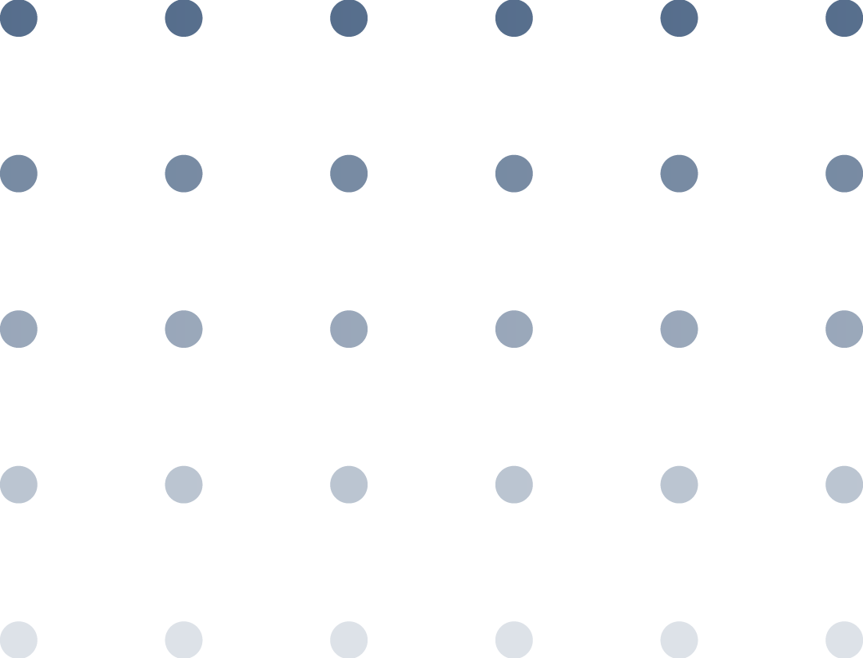
01
Overview

Slide 4
Overview
In today’s educational landscape, students exhibit diverse learning speeds, styles, and preferences. However, the prevailing "one-size-fits-all" model in traditional teaching often:
Leaves behind slow learners
Fails to challenge fast learners
Overburdens teachers managing large classrooms
Students also struggle with concept revision and lack personalized support outside regular class hours.

Slide 5
02
Problem

Slide 6
Problem
In the era of personalized education, students require adaptive learning tools that cater to their performance, behavior, and learning style. Traditional methods lack personalization and early intervention for at-risk students.

Slide 7
03
The Need

Slide 8
The Need for AI-Driven Personalization
Continuously assess student performance and behavior.
Adapt learning materials to individual needs dynamically.
Generate practice questions, summaries, and explanations in real time.
Provide educators with actionable insights into student progress and risks
OUR AIM
THE GOAL
Machine Learning (ML) for performance prediction and behavior modeling.
Deep Learning (DL) for content classification and digit recognition.
Large Language Models (LLMs) for natural language-based feedback, explanation, and summarization

Slide 9
04
Proposed Solutions

Slide 10
Proposed Solutions
This project presents an AI-powered Personalized Learning Assistant that utilizes machine learning and deep learning to:
SOLUTION 1
SOLUTION 2
SOLUTION 3
Predict student performance and grades
Detect learning patterns through clustering
Identify potential dropouts
SOLUTION 4
SOLUTION 5
Recognize handwritten digits
Summarize educational texts

Slide 11
05
Use Cases

Slide 12
1. Predict Student Pass/Fail – Classification Model
Goal: Predict whether a student will pass or fail a quiz or exam.
Data Used: Historical activity, time spent, number of attempts, past scores
Model: Logistic Regression / Classification model
Outcome: Binary classification (Pass/Fail)
Insights: Identified key factors influencing performance, such as hint usage and response time

Slide 13
2. Score Range Prediction – Regression Model
Goal: Predict a student’s exact future score (0–100)
Data Used: Past performance metrics, topic difficulty, time spent per question
Models: Random Forest Regressor & Linear Regression (Baseline)
Outcome: Score prediction with high R²; Random Forest showed better performance

Slide 14
3. Learning Style Clustering
Goal: Group students into clusters like:
Visual Learners
Slow Learners
Fast Responders
Data Used: Reading speed, topic-wise accuracy, interaction behavior
Model: K-Means Clustering
Evaluation: Silhouette Score for cluster validity

Slide 15
4. Dropout Risk Detection
Goal: Predict which students are likely to drop out or become inactive
Data Used: Inactivity periods, engagement consistency, scores over time
Model: XGBoost Classifier
Outcome: High AUC Score; feature importance analysis highlighted key dropout indicators

Slide 16
5. Topic Detection from Student Answers
Goal: Detect the subject area or topic of student-written answers
Data Used: Textual responses labeled by topic
Model: LSTM / BiLSTM
Outcome: Accurate classification into subjects like Math, Science, etc.

Slide 17
6. Handwritten Digit Recognition
Goal: Recognize handwritten digits (0–9) from student-submitted math work
Data Used: MNIST dataset / Real scanned digits
Model: Convolutional Neural Network (CNN)
Outcome: 98%+ accuracy on MNIST; suitable for grading and digit interpretation

Slide 18
7. AI-Based Topic Summarizer
Goal: Generate a 5-line summary of long educational content
Data Used: Articles, lesson transcripts
Model: LLMs (GPT, BART, or T5) via Hugging Face Transformers
Outcome: Coherent, concise summaries personalized to students' reading levels

Slide 19
Live Demo

